Slide 1
Role of Positive Feedback in Employee Well-Being
Working With an Intelligent Assistant in Manufacturing Sector
Akshay Chikhalkar

Slide 2
Overview
Introduction
Hypothesis
Methodology
Discussion
Questions

Slide 3
Overview
Introduction
Hypothesis
Methodology
Discussion
Questions

Slide 4

What is well-being?
Combination of physical, mental, emotional and social health factors
Meaningful positive outcome
Achieved through practising healthy habits
Notes:
Wellbeing is a combination of physical, mental, emotional and social health factors. It is a positive outcome that is meaningful for people and society, achieved through practicing healthy habits on a daily basis. Emotional wellness includes taking time to yourself, smiling and laughing, and seeking or accepting help and support. Well-being also refers to what is intrinsically valuable relative to someone.

Slide 5

Related Studies
Focused on Education, Finance etc. Domains
Supervisor or Manager's point of view
Well-being is related to Feedback
Feedback characteristics are not discussed

Slide 6

Focus of the study
Manufacturing sector
Working with an intelligent assistant
Relation between Affect & Authentic Pride (Well-being) and Positive Task Feedback (Valence)

Slide 7
Overview
Introduction
Hypothesis
Methodology
Discussion
Questions

Slide 8
Hypothesis
"The Positive task feedback would be associated
with an increase in well-being"

Slide 9
Overview
Introduction
Hypothesis
Methodology
Discussion
Questions

Slide 10

Online Survey
Three questionary set
One for significance two for Feedback
40%-40%-20% distribution
Response recorded on Likert Scale (1 to 7)

Slide 11
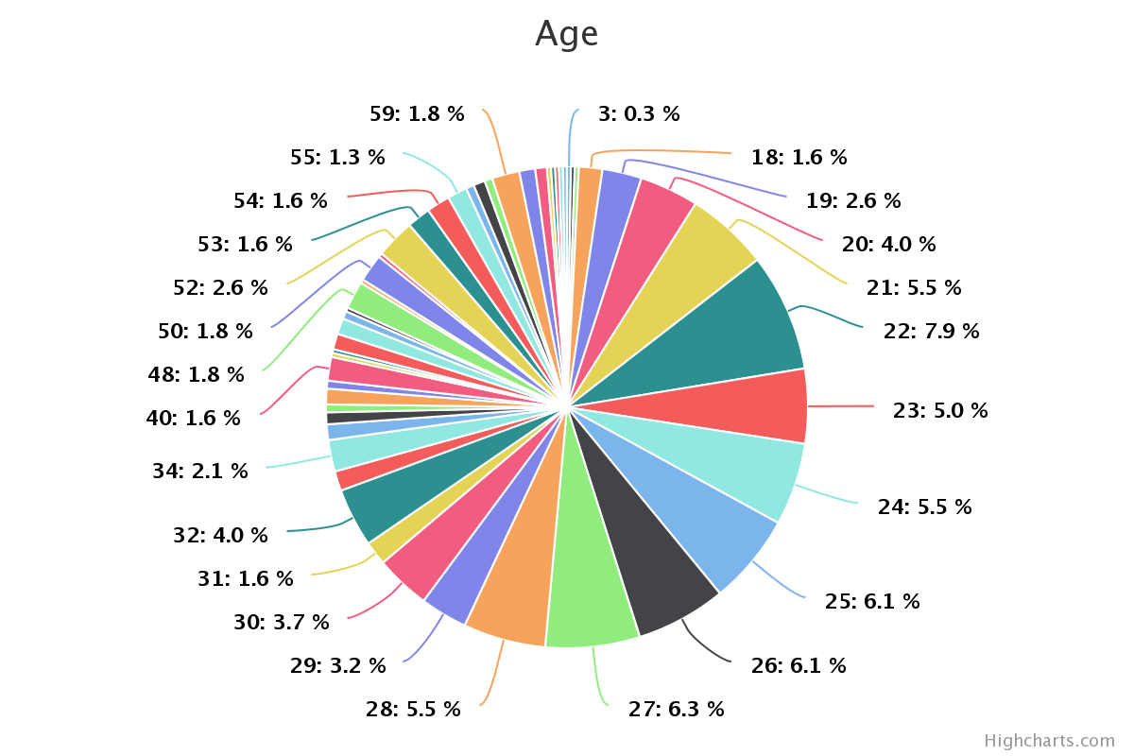
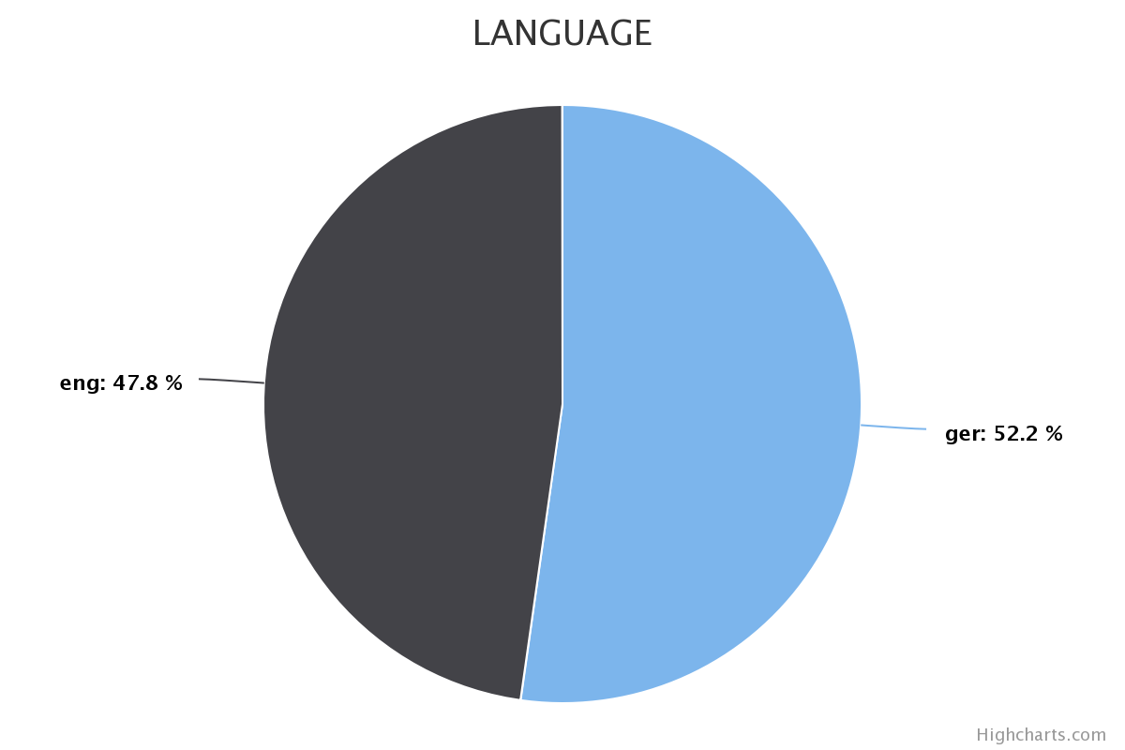
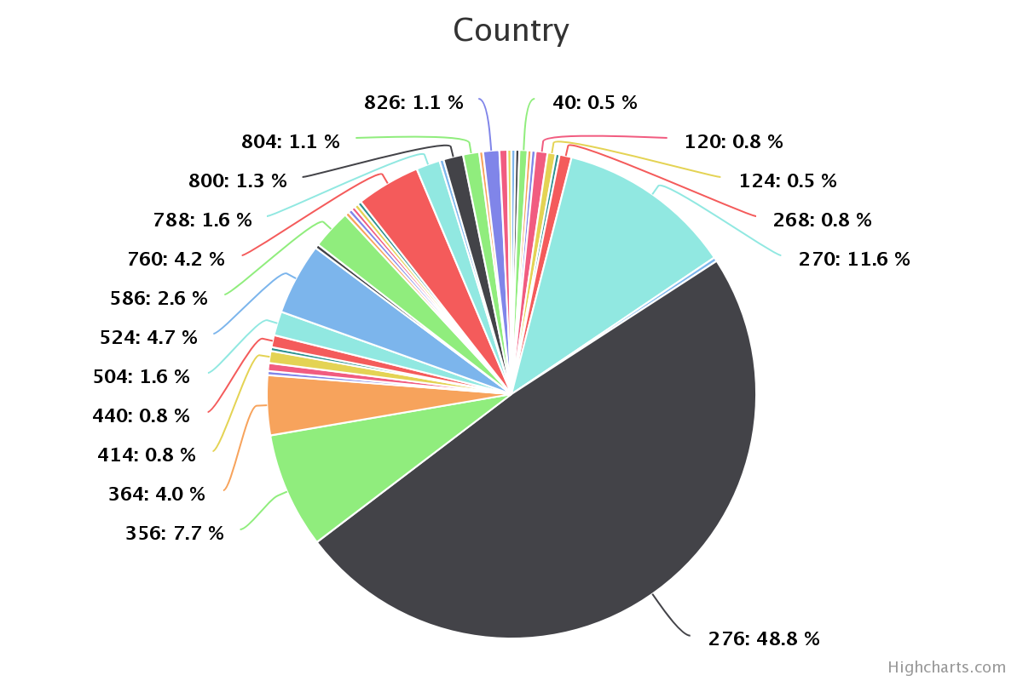
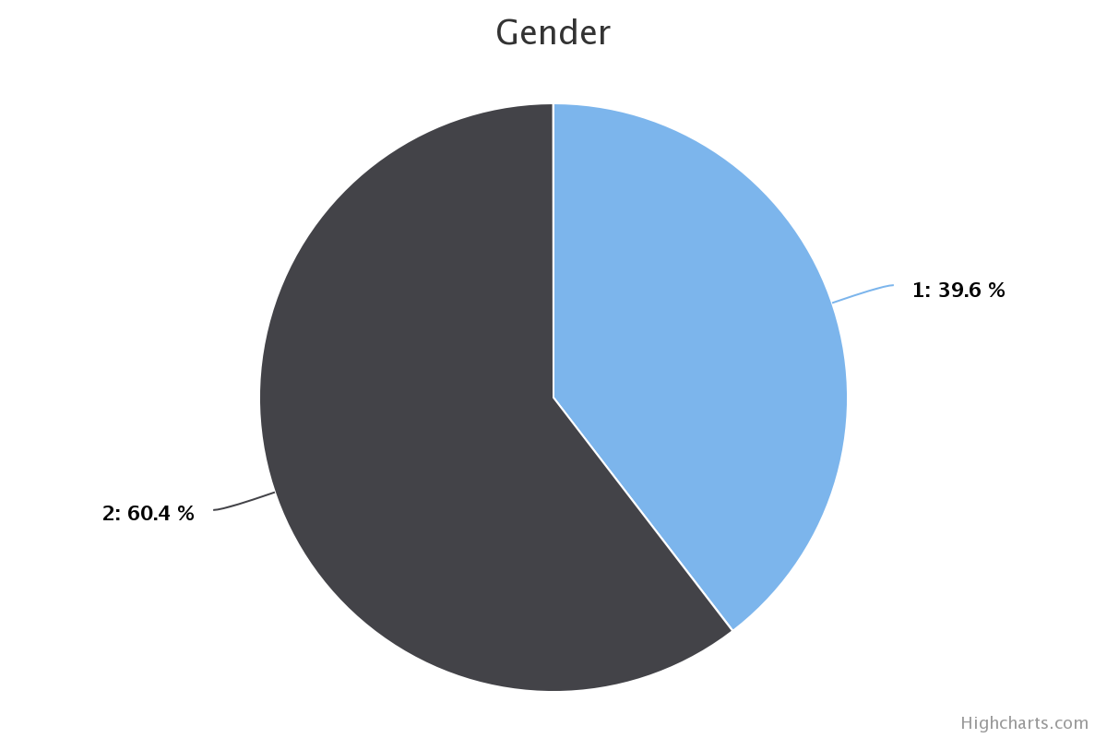
Data Analysis
Between 18 to 40 years
German – 52%
English – 48%
Germany – 49%
Gambia – 12%
India – 8%
Male – 60%
Female – 40%

Slide 12

Data Preparation
Concentration on a questionary set-1 data set
Remove the control group from the valence
Average of variables Satisfied, Successful, Confident (positive affect)

Slide 13

Data Reliability
The Unidimensional Reliability Test
Cronbach’s α lies between 70% to 95%

Slide 14
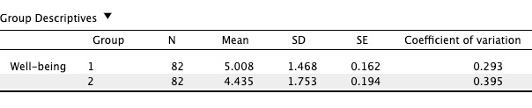
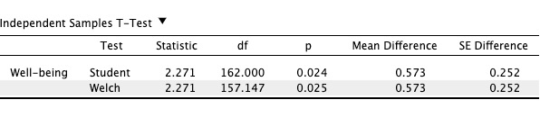
Comparing well-being and positive feedback
Why independent sample T-Test?
Two independent groups
Scaled in intervals (1-7)
Normally distributed
Independent variable – Valence (Positive Task Feedback)
Dependent variable – Well-being (Affect & Authentic Pride)

Slide 15
Overview
Introduction
Hypothesis
Methodology
Discussion
Questions

Slide 16
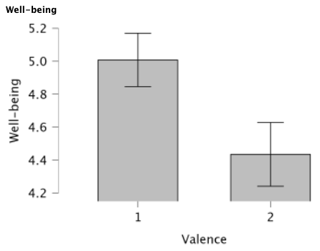
Discussion
Reliable data, Cronbach’s α lies between 70% to 95%
P-value is less than 0.05 (5%)
The alternative hypothesis is accepted
Well-being (Affect & Authentic Pride) increases as positive feedback (Valence) grow

Slide 17
Summary
Introduction
What is well-being?
Related Work
Study Focus
Hypothesis
Methodology
Online Survey
Data Analysis
Data Preparation
Data Reliability
Why Independent Sample T-Test?
Discussion

Slide 18
Overview
Introduction
Hypothesis
Methodology
Discussion
Questions

Slide 19

Questions

Slide 20
Thank you!

